Slide 1

JAVA · OBJECT-ORIENTED PROGRAMMING PROJECT
CLINIC APPOINTMENT AND PRESCRIPTION MANAGER
A practical healthcare workflow built from core java
Team members : P.Tholisri (2620030678)
P.Tanusree (2620030047)
Notes:
Introduce the project as a complete application rather than a collection of isolated exercises. The system brings clinic records, scheduling, prescriptions, and reporting into one classroom-sized healthcare workflow.

Slide 2
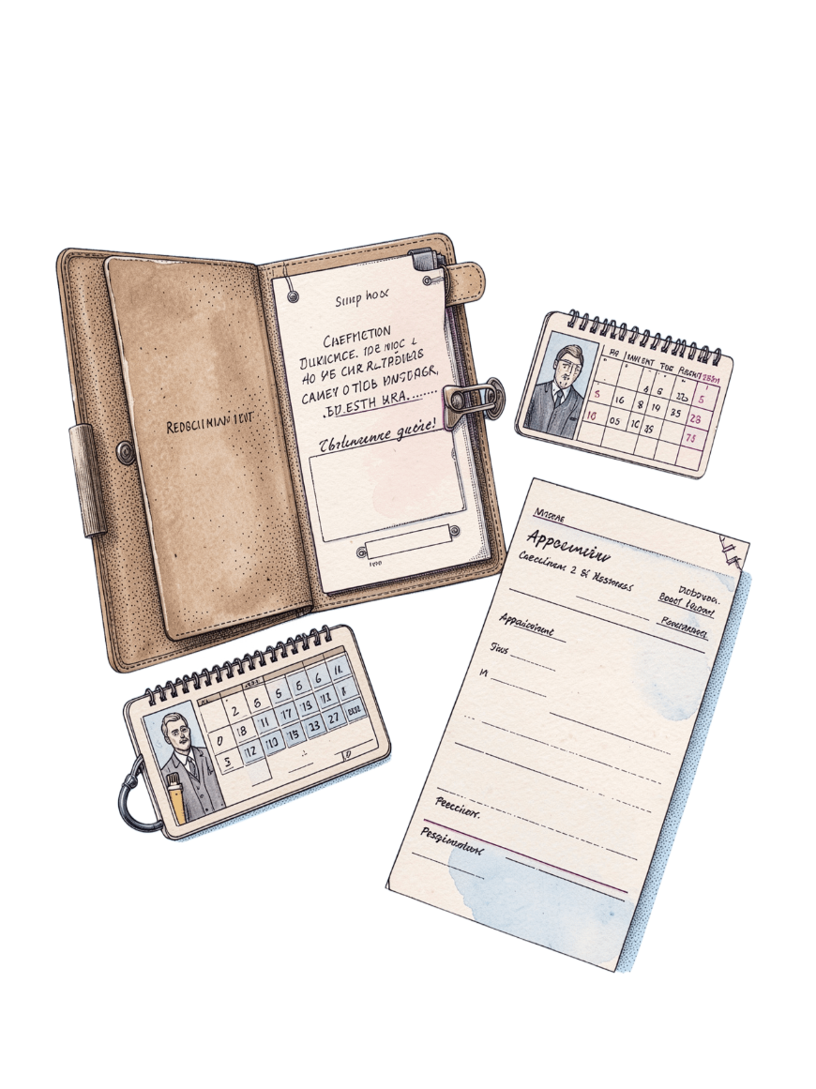
Introduction
From manual registers to a searchable clinic workflow
One application. A Java application for managing patients, doctors, appointments, prescriptions, and medical history.
One structured record. It replaces manual registers with a structured, searchable, and maintainable system.
Six modules together. The project demonstrates how six course modules combine into one practical healthcare workflow.
fig. 1 — the records that meet in one workflow
Notes:
Start with the problem the application addresses: clinic information is easier to manage when patients, doctors, visits, prescriptions, and history belong to one connected system.

Slide 3




Project main objectives
Four capabilities make the project useful
Manage people
Coordinate visits
Register and manage patient and doctor information.
Book, reschedule, cancel, and search appointments.
Protect prescriptions
Apply the course
Create, store, and retrieve prescriptions safely.
Use Java fundamentals, OOP, file handling, collections, and streams.
Notes:
Frame the objectives as the system's four jobs: maintain the people, coordinate visits, handle prescriptions safely, and demonstrate the programming techniques taught in the course.

Slide 4

Advantages, disadvantages, and limitations
Useful by design, bounded by scope
Advantages
Disadvantages
Faster records, fewer duplicate entries, reusable classes, validation, search, and report generation.
Requires correct data entry, Java setup, user training, and regular backup.
fig. 2 — value, responsibility, and boundary
Limitations
Desktop or console scope, basic authentication, local file storage, and no live hospital integration.
Notes:
Present the system honestly. It reduces repetitive work and improves structure, but it still depends on careful users, local setup, backups, and a deliberately limited desktop or console scope.

Slide 5
Future scope
The local prototype can grow into a connected service
01
02
03
04
Reach users
Connect data
Extend care
Strengthen trust
Build a web or mobile interface with role-based login.
Add a relational database, cloud backup, notifications, and online payments.
Integrate telemedicine, lab reports, analytics, and hospital information systems.
Use encryption, audit logs, and privacy controls.
Notes:
Move from the current boundary to the next horizon: a richer interface, durable shared data, connected clinical services, and stronger protection for sensitive healthcare information.

Slide 6
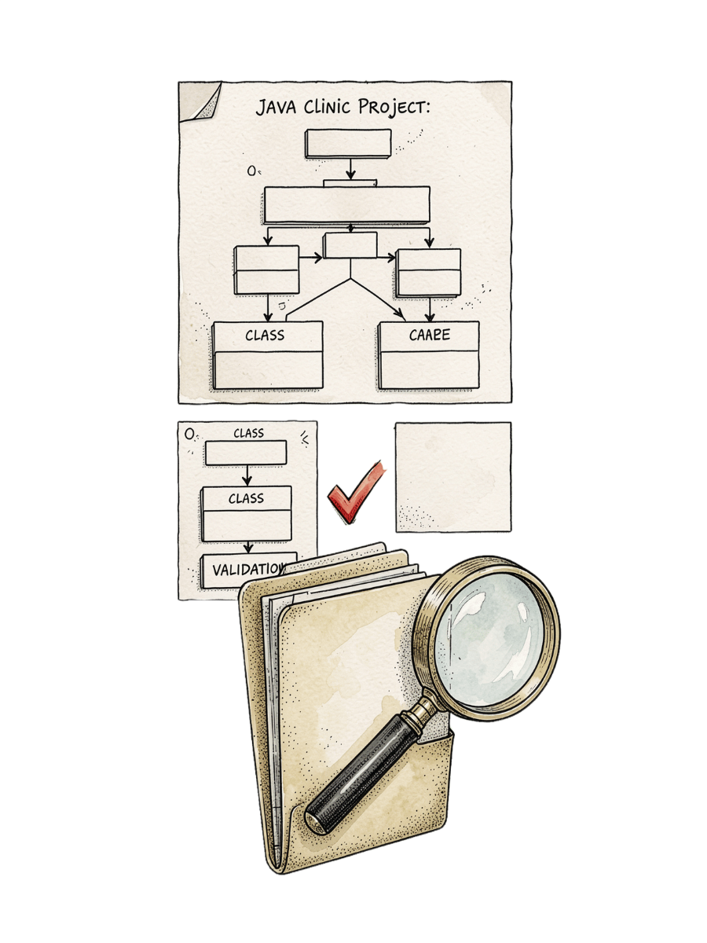
Project development
From requirements to tested records
Analyse. Analyse clinic requirements and draw algorithms and flowcharts.
Model. Design Java classes: Patient, Doctor, Appointment, Prescription, and Clinic.
Implement. Implement menus, conditions, loops, methods, arrays, and validation.
Extend. Add exceptions, strings, file I/O, collections, and stream-based reports.
Test. Test booking, cancellation, prescription, search, and malformed-input scenarios.
fig. 3 — analysis, design, implementation, testing
Notes:
Emphasize the development sequence. The project begins with requirements and algorithms, becomes a set of domain classes, grows through Java features, and is only complete after realistic and malformed-input scenarios are tested.

Slide 7
Course outcomes achieved
CO1 · Think and start
CO2 · Decide and repeat
Apply computational thinking: algorithms, flowcharts, Java syntax, data types, operators, expressions, and console I/O.
Implement selection and iteration for menus, validation, and workflow decisions.
CO3 · Break into methods
CO4 · Model the clinic
Create modular methods; use recursion, arrays, searching, sorting, and aggregation for clinic operations and reports.
Model real entities with classes, objects, encapsulation, inheritance, interfaces, and exception handling.
CO5 · Persist records
CO6 · Find patterns
Strings; Java library algorithms; Path, Files, readers, writers; try-with-resources: process and persist records.
Use collections, generics, lambdas, functional interfaces, streams, and collectors for searching and reports.
Notes:
Use this slide to connect assessment language to visible project behavior. Every course outcome is explicit, and each one can be pointed to in the application's menus, model, storage, search, validation, or reporting features.

Slide 8
Topics covered
The six modules behind the application
Module | Core topics
1 | Module 1: computational thinking, algorithms, flowcharts, Java foundations, operators, typecasting, and Scanner I/O.
2 | Module 2: if, switch, while, do-while, for, break, continue, nested, and infinite loops.
3 | Module 3: methods, parameters, overloading, recursion, arrays, searching, summation, average, and matrices.
4 | Module 4: classes, objects, constructors, this, encapsulation, static members, inheritance, interfaces, overriding, and exceptions.
5 | Module 5: String, StringBuilder, comparison, validation, sorting, searching, file I/O, parsing, and resource handling.
6 | Module 6: List, Set, Map, generics, iterators, lambdas, functional interfaces, pipelines, and collectors.
Notes:
Read the modules as a progression. Early topics create control and structure; object-oriented programming models the clinic; file handling persists it; collections and streams make the records searchable and reportable.

Slide 9
Implementation demo
One patient record, followed from intake to report
01
02
03
04
Add patient
Select doctor
Book appointment
Record consultation
Register the patient and validate the input.
Choose the doctor connected to the visit.
Save the date and time for the consultation.
Attach the visit details to the patient history.
05
06
07
08
Create prescription
Save file
Search history
Generate report
Store the medicine instructions safely.
Persist the record with local file handling.
Retrieve the patient's earlier records.
Use streams to summarize the clinic data.
Notes:
Demonstrate one continuous path rather than isolated screens. Start with a patient, connect the doctor and appointment, record the consultation and prescription, persist the file, retrieve the history, and finish with a stream-based report.

Slide 10
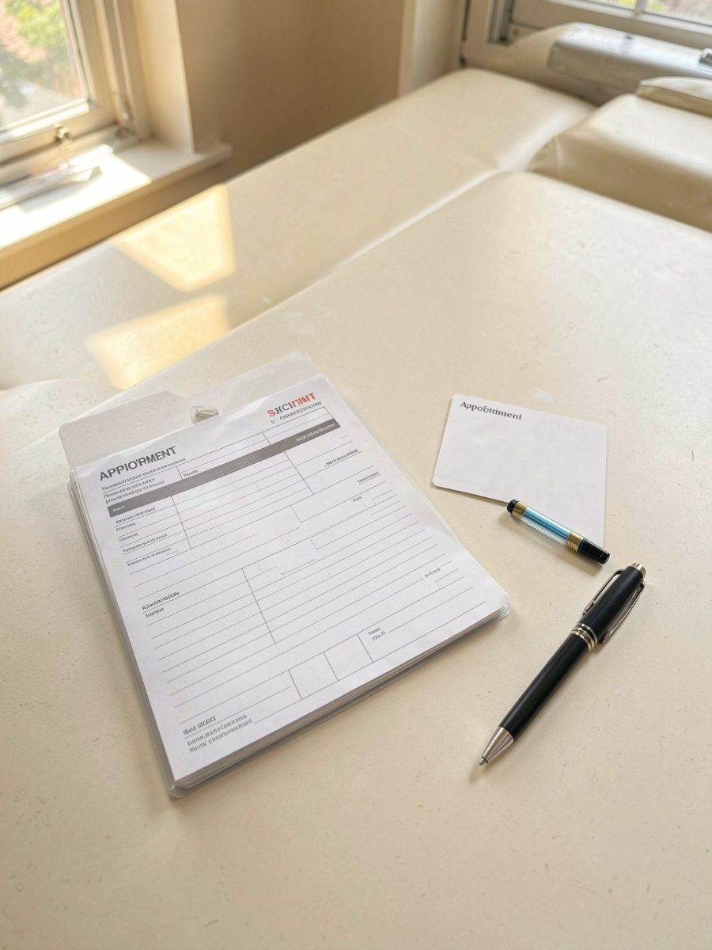
Conclusion
A complete clinic workflow from core Java
Solution. The project converts core Java learning into a complete clinic management solution.
Connection. It connects problem solving, control flow, modular programming, OOP, exception handling, strings, file I/O, collections, and streams.
Foundation. The design is a strong foundation for a secure, database-backed healthcare application.
fig. 4 — a working prototype with room to grow
Notes:
Close by returning to the central claim: the project is both a functioning clinic manager and a demonstration of the course. Its local design is intentionally a foundation for future database, security, and healthcare integration work.

